Slide 1
Synthetic Aperture Radars (SAR)Imaging Basics
ALISHA JOY A

Slide 2
agenda
OVERVIEW
Basic Principles of Radar Imaging
Radar Resolution
Radar equation
Real Aperture Radar
SYNTHETIC APERTURE RADAR
Radar Image Artifacts and Noise
Geometric Effects and Projections
Signal Fading and Speckle

Slide 3

overview
The word “radar” is an acronym for Radio Detection and Ranging.
A radar measures the distance, or range, to an object by transmitting an electromagnetic signal to and receiving an echo reflected from the object.
The total distance traveled by the signal is twice the distance between the radar and the object, since the signal travels from the radar to the object and then back from the object to the radar after reflection. Therefore, once we measured the propagation time (t ), we can easily calculate the range ( R ) as

Slide 4
Basic Principles of Radar Imaging
The cross-track direction, also known as the range direction in radar imaging, is the direction perpendicular to the direction in which the imaging platform is moving. In this direction, radar echoes are separated using the time delay between the echoes that are back-scattered from the different surface elements
The along-track direction, also known as the azimuth direction, is the direction parallel to the movement of the imaging platform.The angular size (in the case of the real aperture radar) or the Doppler history (in the case of the synthetic aperture radar) is used to separate surface pixels in the along-track dimension in the radar images
Within the illumination beam, the radar sensor transmits a very short effective pulse of electromagnetic energy
The brightness associated with each image pixel in the radar image is proportional to the echo power contained within the corresponding time bin.

Slide 5
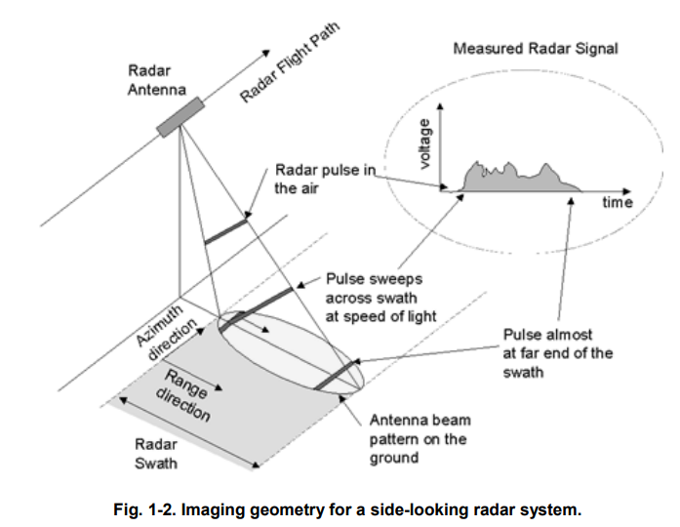

Slide 6
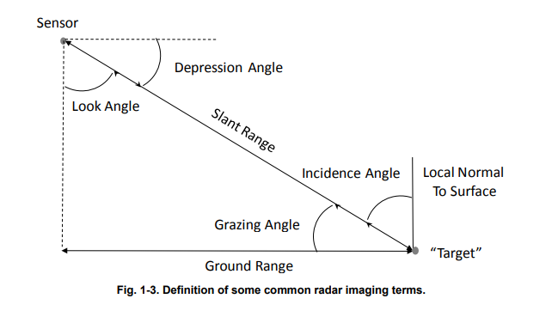

Slide 7
The first is the so-called slant range and refers to the range along the radar line-of-sight
The second use of the term range is for the ground range, which refers to the range along a smooth surface (the ground) to the scatterer.
The ground range is measured from the so-called nadir track, which represents the line described by the position directly underneath the radar imaging platform.
Look Angle:
Defined as the angle between the vertical direction and the radar beam at the radar platform.
Incidence Angle:
Defined as the angle between the vertical direction and the radar wave propagation vector at the surface.
Flat Surface:
When the surface is flat and surface curvature effects are neglected, the look angle equals the incidence angle.
Space-Borne Systems:
For space-borne radar systems, surface curvature must be considered.
This results in the incidence angle being larger than the look angle for flat surfaces.

Slide 8
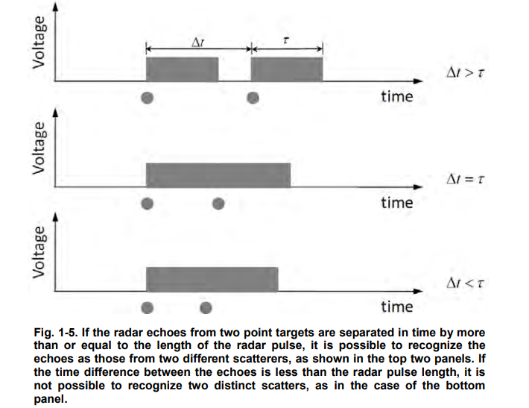
Radar Resolution
The resolution of an image is defined as that separation between the two closest features that can still be resolved in the final image.
Range Resolution: Dependent on pulse duration and system bandwidth.
Ground Range Resolution: Affected by incident angle and pulse length.
Pulse Compression: Enhances resolution through chirp signals and matched filtering.
Bandwidth: Crucial for achieving high resolution, especially in SAR systems.

Slide 9
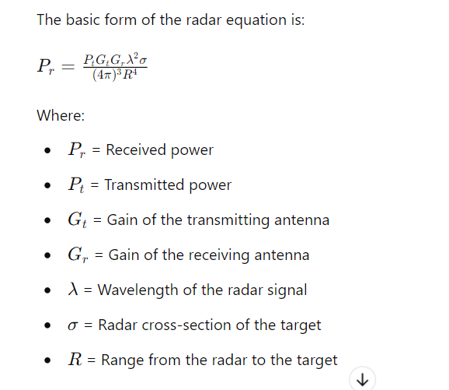
Radar equation

Slide 10
Radar EQUATION
The radar equation is fundamental to understanding how radar systems operate and measure the power of returned signals from targets. It describes the relationship between the transmitted power, the properties of the target, and the received power.
Key Components of the Radar Equation
Transmitted Power (Pt): The power of the signal transmitted by the radar system.
Antenna Gains (Gt and Gr): The gain of the antennas in the direction of the target. High gain antennas focus more power in a specific direction, enhancing the signal strength.
Wavelength (λ): The wavelength of the radar signal. Shorter wavelengths (higher frequencies) provide better resolution.
Radar Cross-Section (σ): A measure of how much of the radar signal is reflected back by the target. It depends on the size, shape, and material of the target.
Range (R): The distance from the radar to the target. The received power decreases with the fourth power of the range, making it a critical factor in radar performance.

Slide 11

Real Aperture Radar
RAR is a radar imaging system that uses an antenna to illuminate the surface, forming images based on the reflected signals.
Beam Formation: The antenna emits a fan beam that illuminates an elongated elliptical area on the surface, defining the radar's imaging capabilities.
Swath Width: The swath width S is calculated by the equation
considering the sensor height h and angle θ

Slide 12
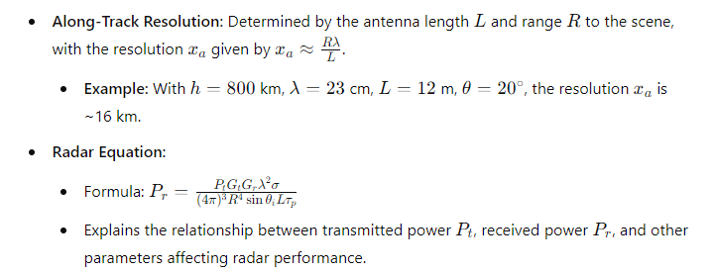
Real Aperture Radar
RAR achieves poorer resolutions compared to passive optical systems.
The technology has been largely superseded by more advanced radar systems
like Synthetic Aperture Radar (SAR).

Slide 13
Synthetic Aperture Radar
Doppler Effect: As the radar moves, objects ahead of the radar appear to have a slightly higher frequency in the returned signal, while objects behind have a slightly lower frequency.
Using Frequency Differences: By analyzing these slight differences in frequency (Doppler shifts), the radar can distinguish between objects that are close together along the direction of flight. This helps in creating a sharper and more detailed image.
coherent radar : The radar compares the phase of the returned signal with the phase of the transmitted signal. This comparison helps determine the exact position and velocity(speed) of the object.
imagine the radar is moving along a straight line. As it gets closer to the target, the distance between the radar and the target decreases until it reaches the closest point. After that, the distance starts increasing again as the radar moves away. This equation calculates that changing distance at any moment in time.
The first equation calculates the exact distance between the radar and the target as the radar moves.
The second equation is a simpler version that's easier to use, and it's still accurate enough when the radar is moving slowly compared to how far it is from the target.

Slide 14
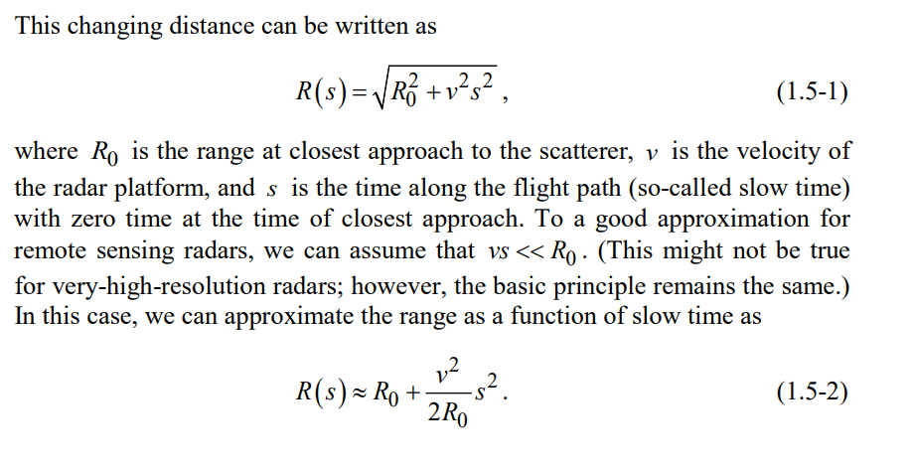
Synthetic Aperture Radar
resolution in the azimuth direction is determined by the length of the radar antenna. Specifically, the resolution is half the length of the antenna. For example, if the antenna is 2 meters long, the azimuth resolution would be 1 meter.

Slide 15
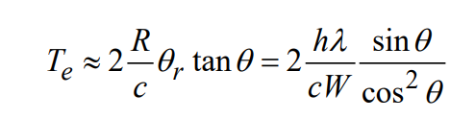
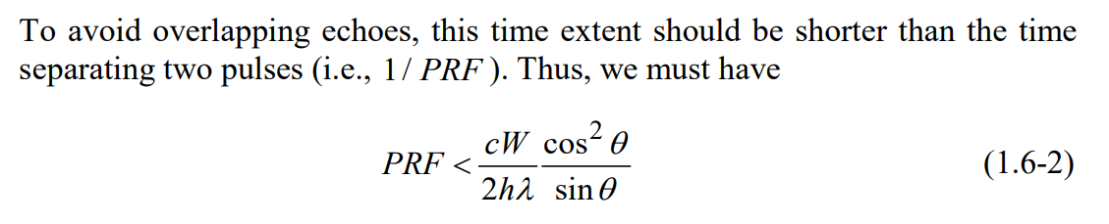
Radar Image Artifacts and Noise
range and azimuth ambiguities
If the timing of the pulses or the extent of the echoes is such that the leading edge of one echo overlaps with the tail end of the previous one, then the far edge of the scene is folded over the near edge of the scene. This is called range ambiguity.
The temporal extent of the echo refers to the duration of time over which a radar pulse's echo is received after it has been transmitted and reflected off the surface being imaged. . The temporal extent of the echo is equal to:

Slide 16
Radar Image Artifacts and Noise
Azimuth ambiguity can lead to the appearance of "ghost" images or multiple copies of a single object in the radar image.
Azimuth ambiguity occurs when the radar's pulse repetition frequency (PRF) is too low relative to the Doppler bandwidth of the signals being received.

Slide 17
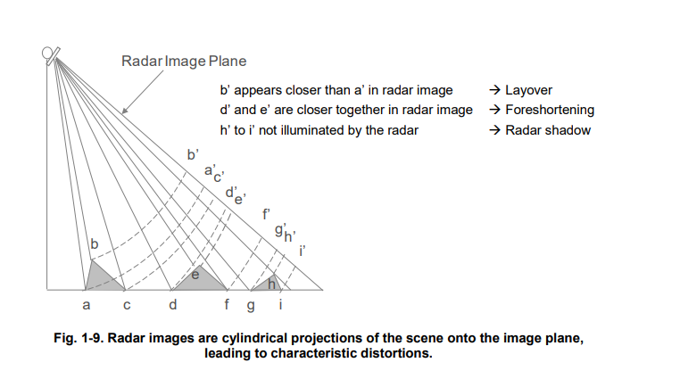
Geometric Effects and Projections

Slide 18
Geometric Effects and Projections
1. Foreshortening
Definition: Foreshortening occurs when areas that slope toward the radar sensor appear compressed or shorter in the radar image.
Cause: This happens because the radar waves hit the slope at a steeper angle, causing the return signals to be received in a shorter time span.
Effect: Objects or terrain features that slope toward the radar sensor will look shorter in the image compared to their actual size.
2. Layover
Definition: Layover occurs when the slope of the terrain is steeper than the radar’s incidence angle, causing the top of the slope to appear closer to the radar than the base.
Cause: When the slope angle exceeds the radar’s incidence angle, the radar waves hit the top of the slope before the base, making the top appear to be “laid over” the base in the image.
Effect: This results in a distortion where the hill or slope looks as if it is projected over the area in front of it. Layover cannot be corrected and is best avoided by choosing an incidence angle larger than any expected surface slopes.
3. Shadowing
Definition: Shadowing occurs when the radar waves do not illuminate the area on a slope facing away from the radar sensor, resulting in a dark or unilluminated area in the radar image.
Cause: If the slope facing away from the radar is steep enough, the radar waves will not reach it, creating a shadow.
Effect: The shadowed area will not be imaged, appearing as a dark region in the radar image. Unlike optical images, radar shadowing is always away from the sensor flight line and is not influenced by the time of day or the Sun’s angle

Slide 19

Signal Fading and Speckle
A close examination of a synthetic-aperture radar image shows that the brightness variation is not smooth but, instead, has a granular texture that is called speckle.
Reducing Noise (Speckle)
Incoherent Averaging: By averaging the power values of successive signals or neighboring pixels, we can reduce the brightness fluctuations (speckle). This makes the image look smoother and more accurate, but it can reduce the image resolution.
Combining Images at Different Frequencies: Another way to reduce speckle is to combine images taken at slightly different frequencies. This results in independent signals with the same statistical properties, and averaging them smooths out the image
Signal Standard Deviation (S_N): The standard deviation of the signal (S_N) is related to the mean signal power (P) by the equation This means that as you increase the number of looks (N), the standard deviation (variation) of the signal decreases, leading to a smoother image.

Slide 20

Thank you

